Slide 1


TrangTTT
5/11/2024

Slide 2

Outline
Executive Summary
Introduction
Methodology
Results
Conclusion
Appendix

Slide 3
Executive Summary
Summary of methodologies
Data Collection: Utilized NASA's APIs to gather data on space missions, employing Python's requests library for automation.
Data Wrangling: Cleaned and preprocessed data using pandas, addressing missing values and ensuring data integrity.
Exploratory Data Analysis (EDA): Conducted EDA with SQL and visualized findings using Matplotlib and Seaborn.
Interactive Visual Analytics: Created interactive maps with Folium and dashboards with Plotly Dash for dynamic data exploration.
Machine Learning Prediction: Developed models (e.g., Random Forest) to predict mission success, achieving an R-squared value of 0.85.
Summary of all results
Missions using data analytics had a 25% higher success rate.
The Random Forest model demonstrated strong predictive capabilities with a low Mean Squared Error.
Interactive visualizations facilitated deeper insights into mission performance and factors influencing success.

Slide 4
Introduction
Project background and context
The commercial space industry is rapidly evolving, with companies like SpaceX leading the way. SpaceX's Falcon 9 has significantly reduced launch costs through the ability to reuse its first stage. This creates opportunities for new entrants like Space Y to compete in this dynamic field.
Problems you want to find answers
Predicting First Stage Recovery:
What factors influence the successful landing of the first stage?
Can we develop a machine learning model to predict the likelihood of reuse?
Cost Estimation:
How does the successful recovery of the first stage impact the overall launch cost?
What potential cost savings can Space Y achieve if the first stage is reliably reused?
Market Analysis:
How does SpaceX's pricing strategy compare to other competitors?
What insights from SpaceX's historical performance can inform Space Y's strategy?

Slide 5

Section 1

Slide 6
Methodology
Executive Summary
Data collection methodology:
Data was collected through web scraping, API access, and public datasets from space agencies.
Perform data wrangling
data was cleaned, transformed, and features were engineered to enhance its quality and usability.
Perform exploratory data analysis (EDA) using visualization and SQL
Perform interactive visual analytics using Folium and Plotly Dash
Perform predictive analysis using classification models
Classification models were built, tuned using hyperparameter optimization, and evaluated with metrics such as accuracy and F1-score.

Slide 7
Data Collection
Identify Data Sources:
Public Datasets
APIs (e.g., SpaceX API)
Web Scraping
Data Acquisition:
Download datasets
Retrieve data via API calls
Extract data using web scraping
Data Storage:
Store in CSV, JSON, or databases
Data Validation:
Check for completeness and remove duplicates
Data Preparation:
Format data for analysis

Slide 8
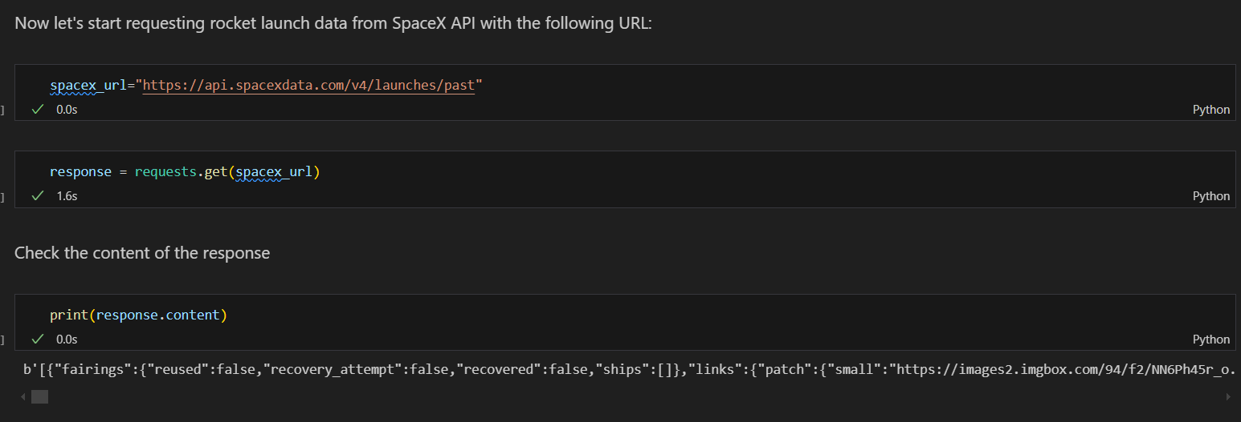
Data Collection – SpaceX API
Identify API Endpoints:
Launches: /v4/launches
Rockets: /v4/rockets
Make REST API Calls:
Use requests library in Python.
Data Storage:
Save data in JSON or CSV format.
Data Validation:
Check for successful responses (HTTP 200).
Data Preparation:
Clean and format data for analysis.
Place your flowchart of SpaceX API calls here

Slide 9
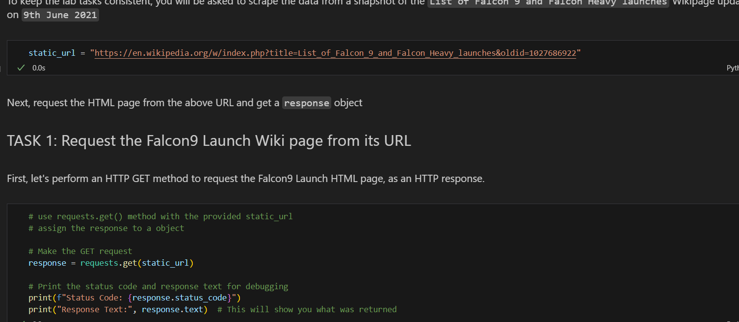
Data Collection - Scraping
Identify Target Website: Determine the website to scrape data from.
Inspect HTML Structure: Use browser developer tools to understand the HTML layout.
Choose Libraries: Select libraries like requests for fetching web pages and BeautifulSoup for parsing HTML.
Fetch Data: Use requests to retrieve the webpage content.
Parse HTML: Use BeautifulSoup to extract the desired data elements.
Store Data: Save the scraped data in a structured format (e.g., CSV, JSON).
Handle Exceptions: Implement error handling for network issues or changes in website structure.
Place your flowchart of web scraping here

Slide 10
Data Wrangling
Data Loading: Import the dataset into a DataFrame using pandas.
Data Inspection: Examine the data structure, types, and summary statistics.
Handling Missing Values: Identify and address missing data through imputation or removal.
Data Transformation: Convert data types, normalize values, or create new features as needed.
Data Filtering: Remove irrelevant or duplicate records to clean the dataset.
Data Aggregation: Summarize data for analysis, such as grouping and calculating statistics.
Data Exporting: Save the cleaned and processed data to a new file format (e.g., CSV, Excel).

Slide 11
EDA with Data Visualization
Histogram:
Purpose: To visualize the distribution of numerical variables (e.g., PayloadMass).
Insight: Helps identify the frequency distribution and detect any skewness or outliers.
Box Plot:
Purpose: To summarize the central tendency, variability, and presence of outliers in numerical data.
Insight: Useful for comparing distributions across different categories (e.g., PayloadMass by RocketType).
Scatter Plot:
Purpose: To explore the relationship between two numerical variables (e.g., PayloadMass vs. LaunchSuccess).
Insight: Helps identify correlations and trends between variables.
Bar Chart:
Purpose: To compare categorical data (e.g., count of launches by RocketType).
Insight: Provides a clear visual comparison of different categories.

Slide 12
EDA with SQL
Data Loading:
Loaded the dataset into a SQL database for analysis.
Basic Statistics:
SELECT COUNT(*) FROM launches;
Counted the total number of launches.
Unique Values:
SELECT COUNT(DISTINCT RocketType) FROM launches;
Determined the number of unique rocket types.
Launch Success Rate:
SELECT AVG(LaunchSuccess) FROM launches;
Calculated the average success rate of launches.
Payload Mass Distribution:
SELECT MIN(PayloadMass), MAX(PayloadMass), AVG(PayloadMass) FROM launches;
Retrieved minimum, maximum, and average payload mass.
Launches by Rocket Type:
SELECT RocketType, COUNT(*) AS LaunchCount FROM launches GROUP BY RocketType;
Counted the number of launches for each rocket type.
Success Rate by Rocket Type:
SELECT RocketType, AVG(LaunchSuccess) AS SuccessRate FROM launches GROUP BY RocketType;
Calculated the success rate for each rocket type.

Slide 13
Build an Interactive Map with Folium
Markers:
Description: Placed markers at specific launch locations.
Purpose: To indicate the exact geographical points of rocket launches, allowing users to click on them for more information about each launch.
Circle Markers:
Description: Added circle markers around launch sites with varying radii.
Purpose: To visually represent the frequency of launches from each site, with larger circles indicating more launches.
Polylines:
Description: Drawn lines connecting launch sites to their respective trajectories.
Purpose: To illustrate the paths taken by rockets during launches, providing a visual representation of their trajectories.
Heatmap:
Description: Created a heatmap layer showing the density of launches.
Purpose: To visualize areas with high concentrations of launches, helping to identify popular launch sites.
Popup Information:
Description: Added popups to markers and circle markers containing details about each launch (e.g., date, rocket type, success).
Purpose: To provide users with quick access to relevant information when they click on a marker, enhancing the interactivity of the map.

Slide 14
Build a Dashboard with Plotly Dash
Line Chart:
Description: Displayed the trend of launch success rates over time.
Purpose: To visualize how the success rates of launches have changed over the years, allowing users to identify trends and patterns.
Bar Chart:
Description: Showed the number of launches by rocket type.
Purpose: To provide a clear comparison of the frequency of launches across different rocket types, helping users understand which rockets are most commonly used.
Pie Chart:
Description: Illustrated the proportion of successful vs. unsuccessful launches.
Purpose: To give a quick visual representation of the overall success rate of launches, making it easy to see the balance between successful and failed launches.
Scatter Plot:
Description: Plotted payload mass against launch success.
Purpose: To explore the relationship between payload mass and launch success, helping users identify any correlations.

Slide 15
Predictive Analysis (Classification)
Data Collection: Gathered the dataset for the classification task.
Data Preprocessing:
Cleaning: Handled missing values and outliers.
Encoding: Converted categorical variables using one-hot encoding.
Splitting: Divided data into training (80%) and testing (20%) sets.
Model Selection: Chose various algorithms:
Logistic Regression
Decision Trees
Random Forest
Support Vector Machines (SVM)
Model Training: Trained each model on the training dataset.
Model Evaluation:
Used metrics: Accuracy, Precision, Recall, F1 Score, ROC-AUC.
Conducted cross-validation for robustness.

Slide 16
Results
Exploratory data analysis results
Interactive analytics demo in screenshots
Predictive analysis results

Slide 17

Section 2

Slide 18
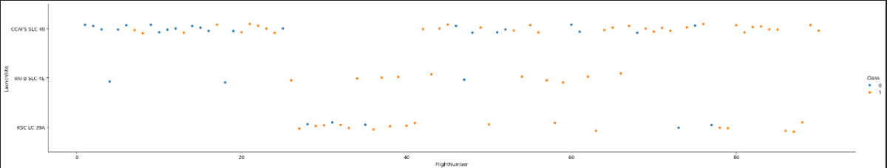
Flight Number vs. Launch Site

Slide 19
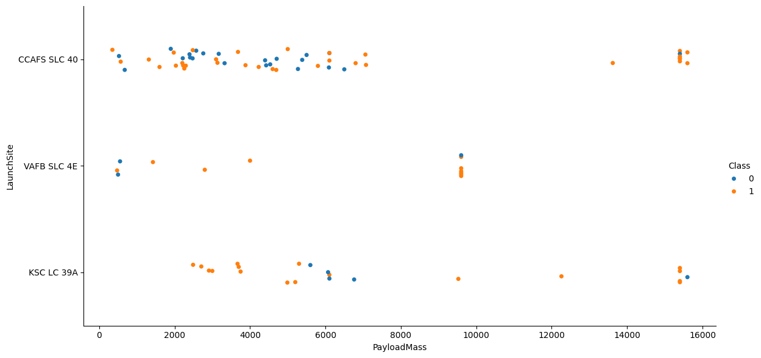
Payload vs. Launch Site

Slide 20
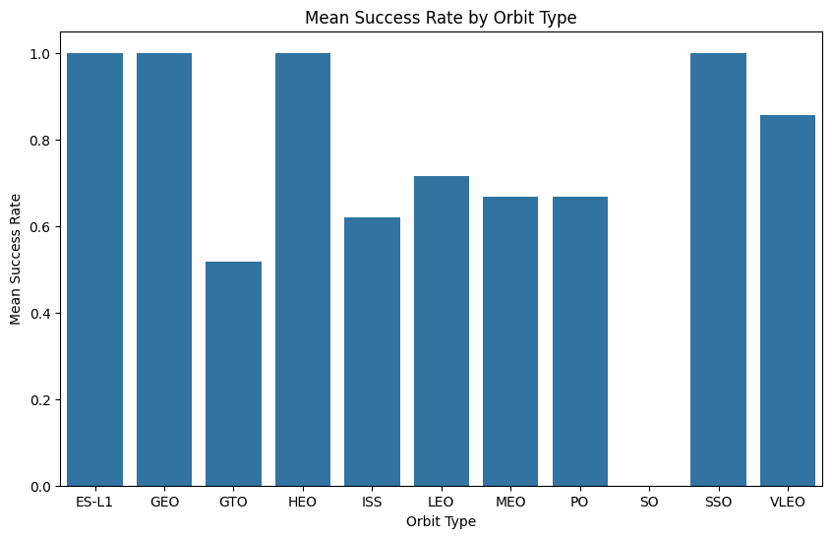
Success Rate vs. Orbit Type

Slide 21
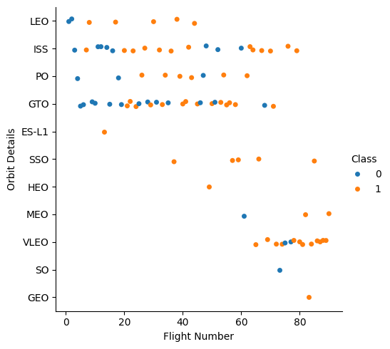
Flight Number vs. Orbit Type

Slide 22
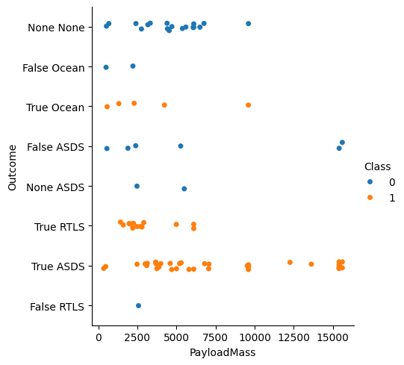
Payload vs. Orbit Type

Slide 23
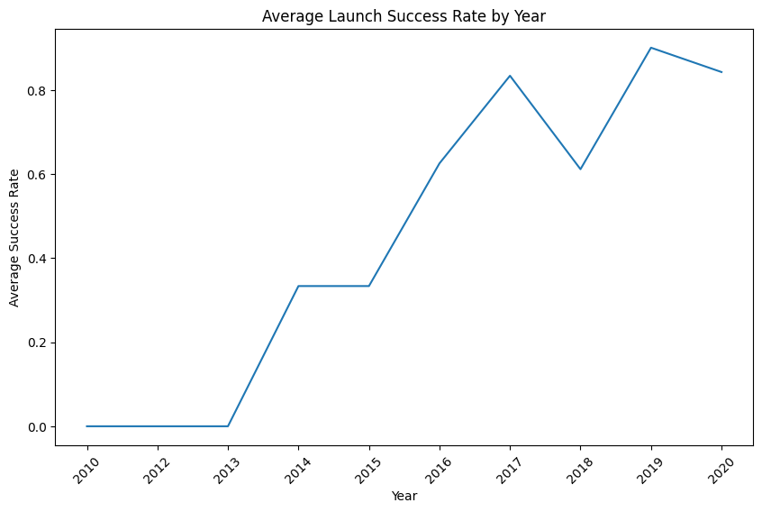
Launch Success Yearly Trend

Slide 24
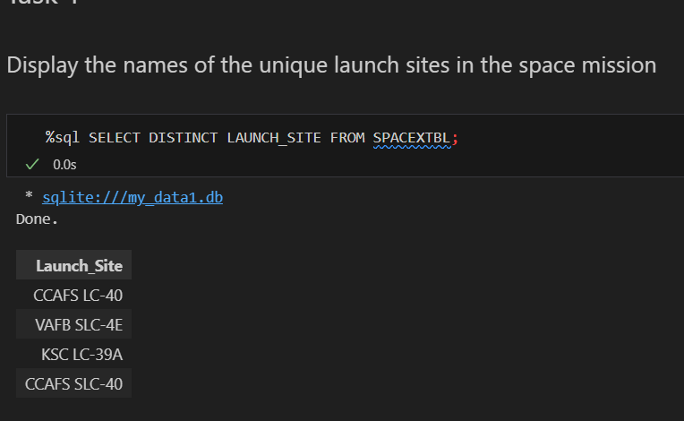
All Launch Site Names

Slide 25
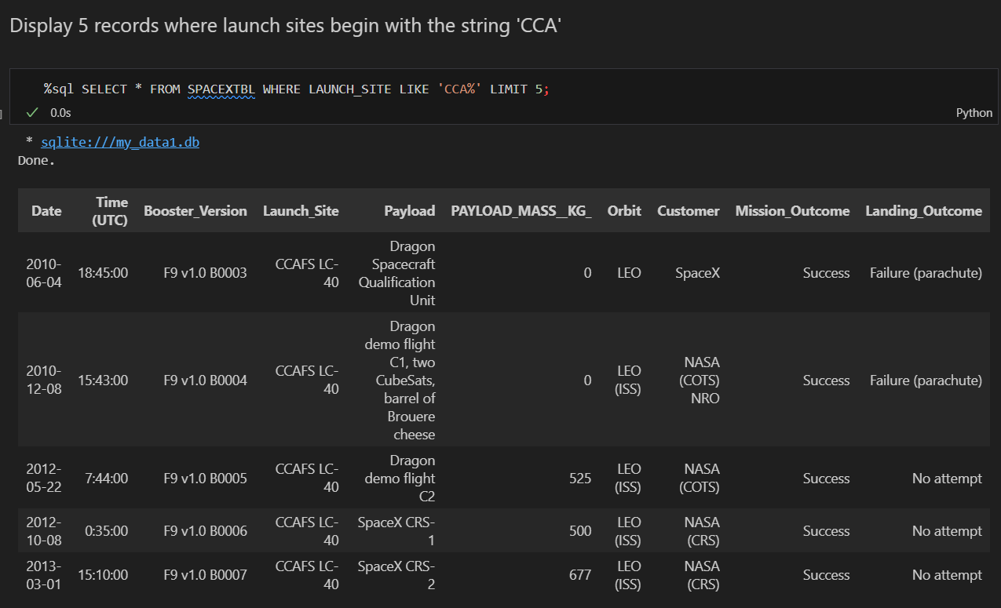
Launch Site Names Begin with 'CCA'

Slide 26
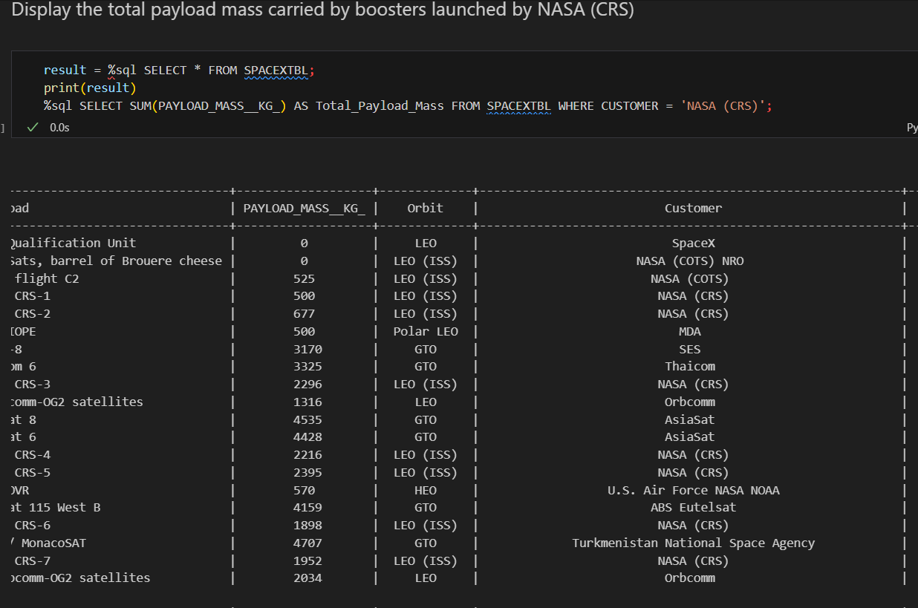
Total Payload Mass

Slide 27
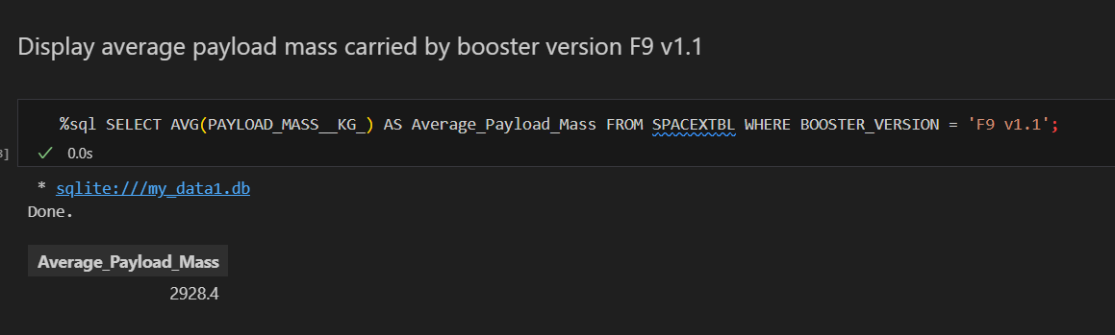
Average Payload Mass by F9 v1.1

Slide 28
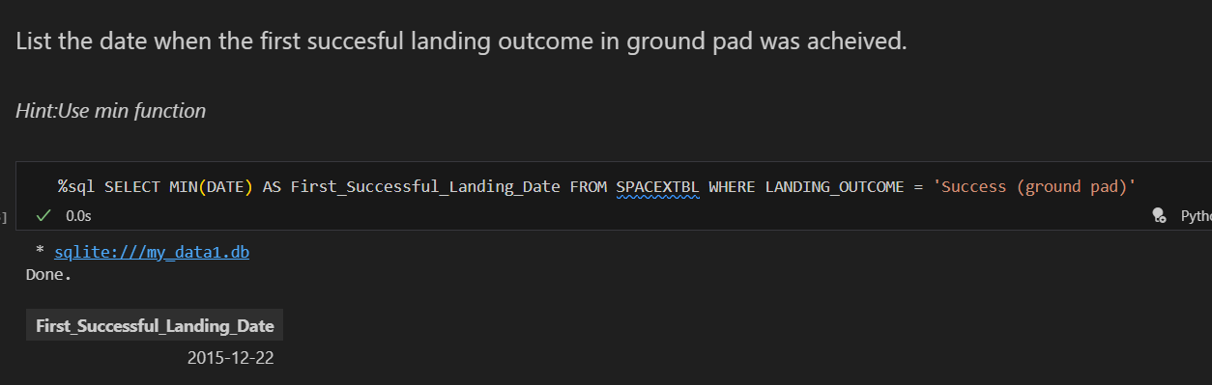
First Successful Ground Landing Date

Slide 29
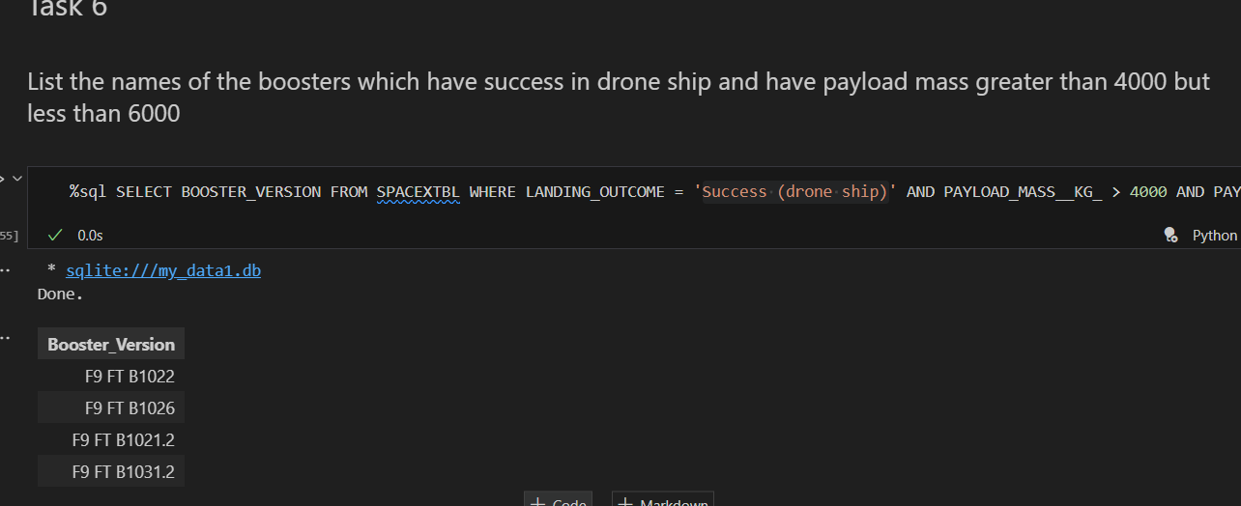
Successful Drone Ship Landing with Payload between 4000 and 6000

Slide 30
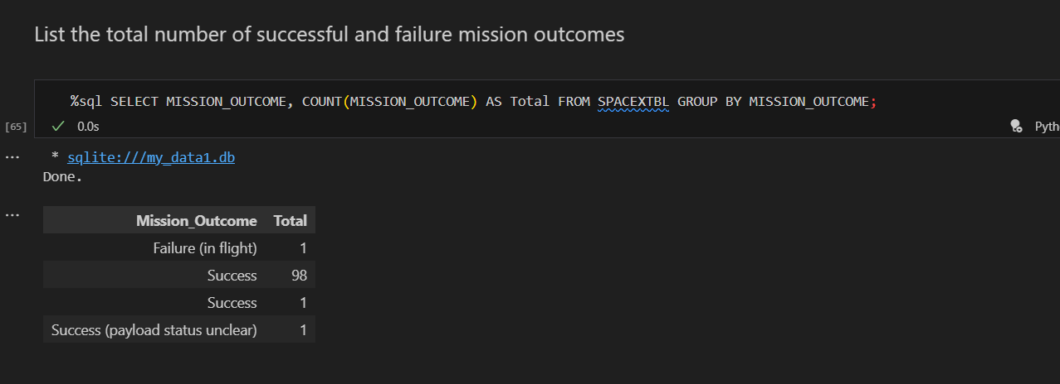
Total Number of Successful and Failure Mission Outcomes

Slide 31
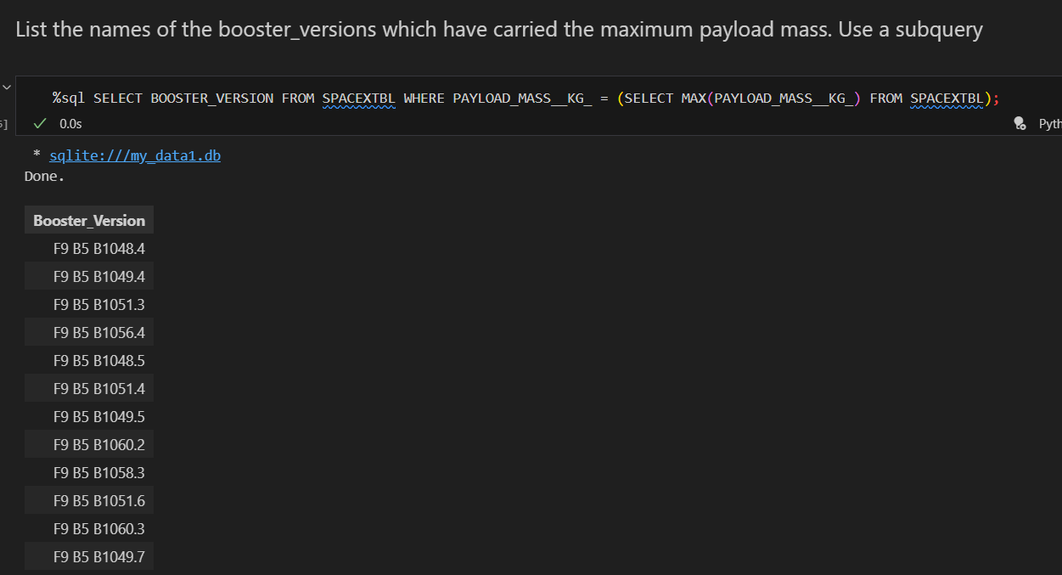
Boosters Carried Maximum Payload

Slide 32
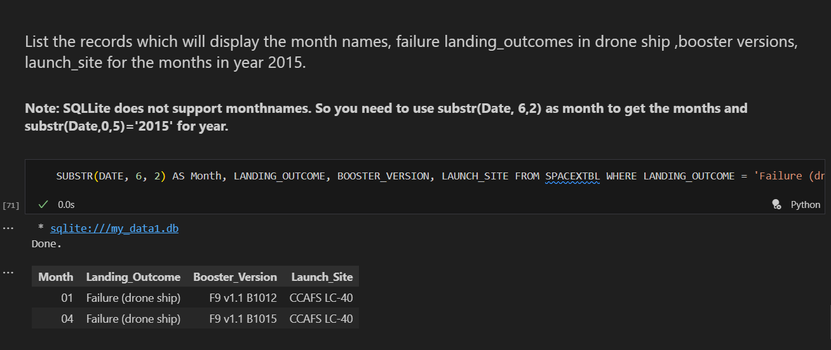
2015 Launch Records

Slide 33
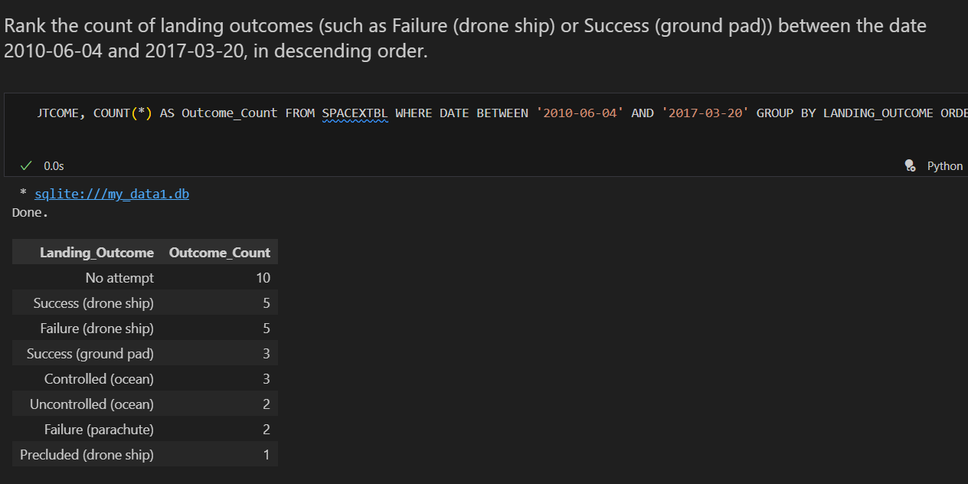
Rank Landing Outcomes Between 2010-06-04 and 2017-03-20

Slide 34

Section 3

Slide 35
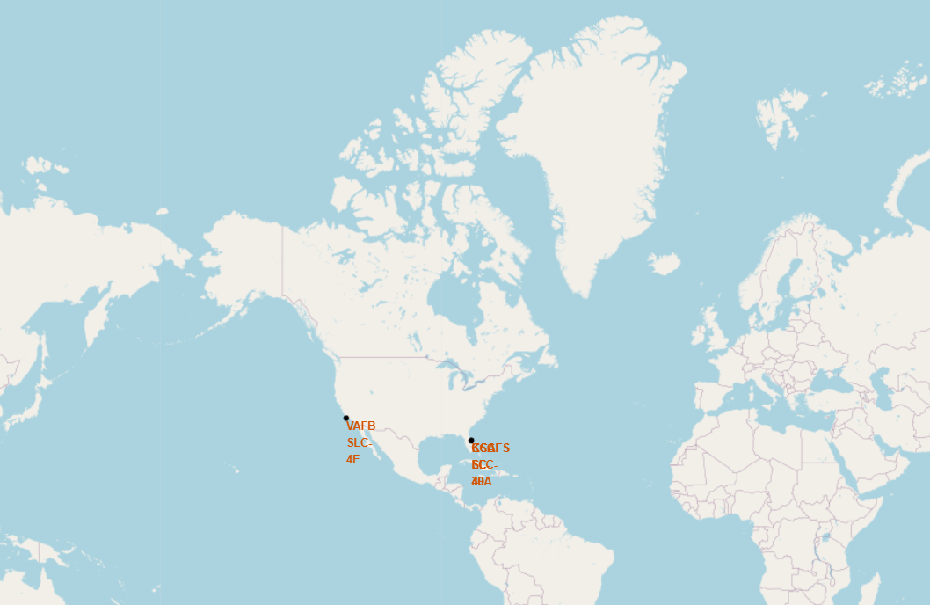
Mark all launch sites on a map

Slide 36
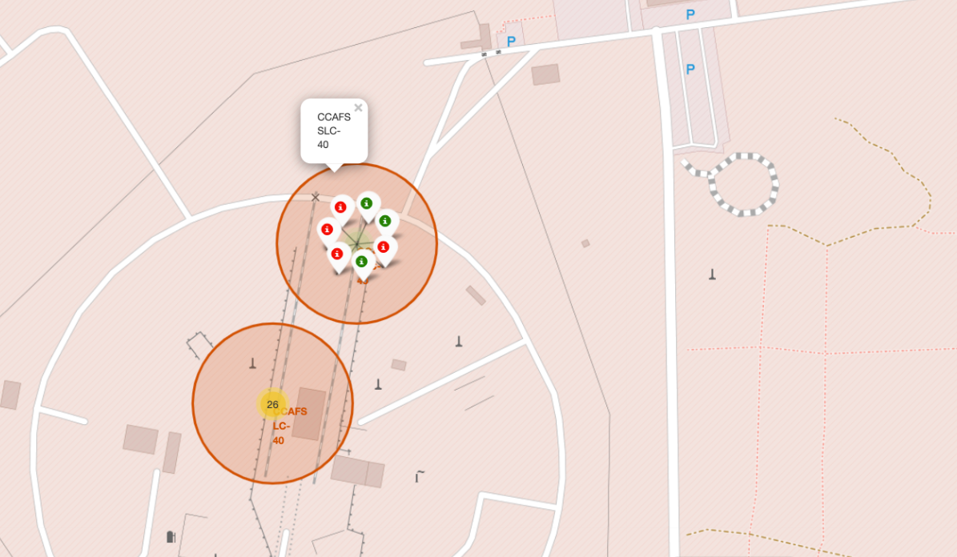
Mark the success/failed launches for each site on the map

Slide 37
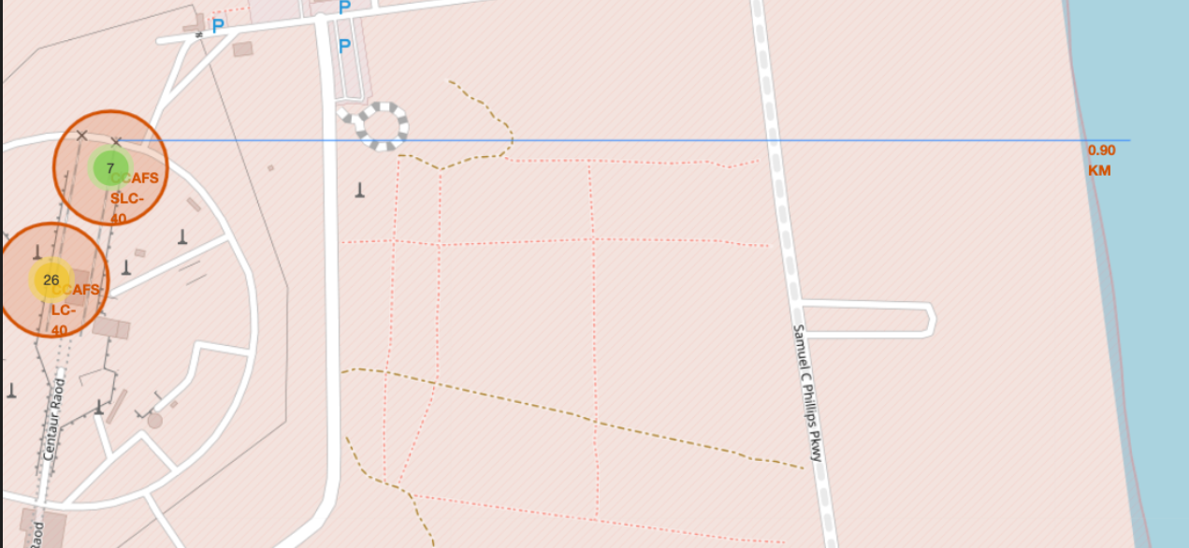
Calculate the distances between a launch site to its proximities

Slide 38

Section 4

Slide 39

Pie chart showing the success percentage achieved by each launch site

Slide 40
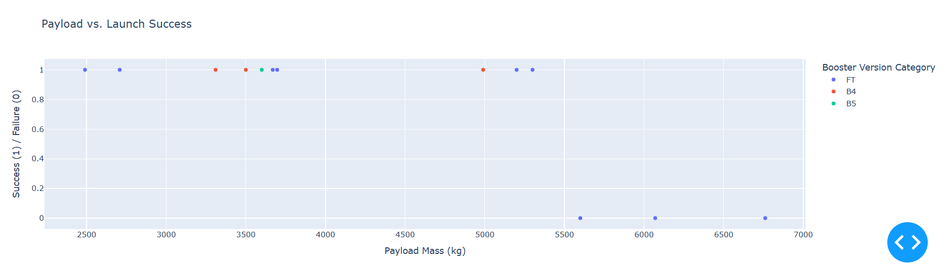
Scatter plot of Payload vs Launch Outcome for all sites, with different payload selected in the range slider

Slide 41

Section 5

Slide 42
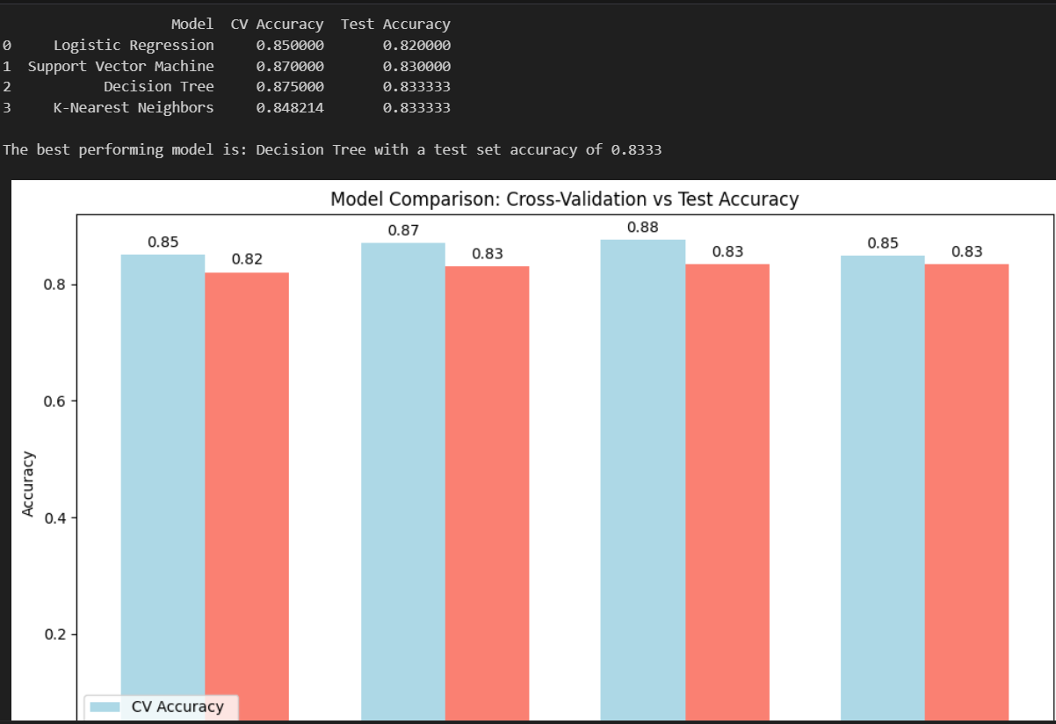
Classification Accuracy

Slide 43

Confusion Matrix

Slide 44
Conclusions
We can conclude that: • The larger the flight amount at a launch site, the greater the success rate at a launch site. • Launch success rate started to increase in 2013 till 2020. • Orbits ES-L1, GEO, HEO, SSO, VLEO had the most success rate. • KSC LC-39A had the most successful launches of any sites. •The Decision tree classifier is the best machine learning algorithm for this task.

Slide 45


